Slide 1
Childhood Pneumonia Detection
Rebecca Mih

Slide 2
Pneumonia is the world’s leading infectious killer of children, claiming the lives of more than 800,000 children under the age of five every year, more than 2,000 every day.
These deaths are preventable
Unicef, 2019
Notes:
This is the question that your experiment answers

Slide 3
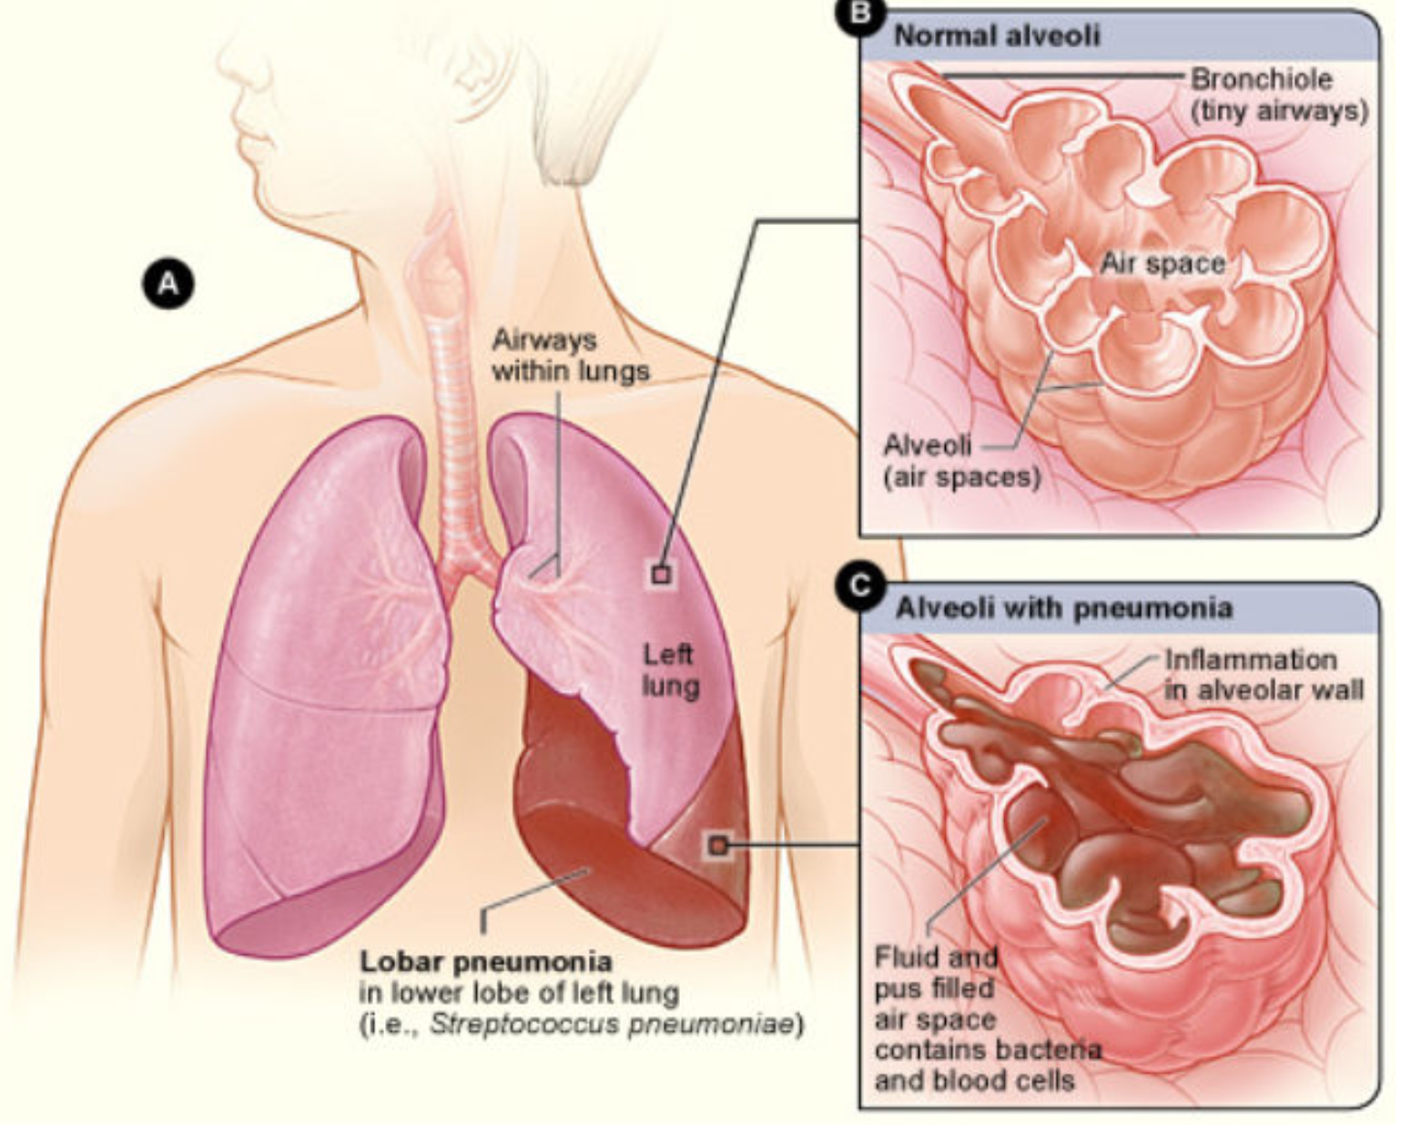
What is Childhood Pneumonia?
Pneumonia is an infection in the lungs
The airsacs (alveoli) fill with fluid and pus making breathing difficult, or painful
Most often caused by bacteria, viruses or fungi.
Bacterial pneumonia must be treated timely with antibiotics
This project uses neural networks to classify whether an chest x-ray of a sick child indicates pneumonia (either bacterial or viral)
Childhood Pneumonia JAMA. 2017;318(5):490. doi:10.1001/jama.2017.9428

Slide 4
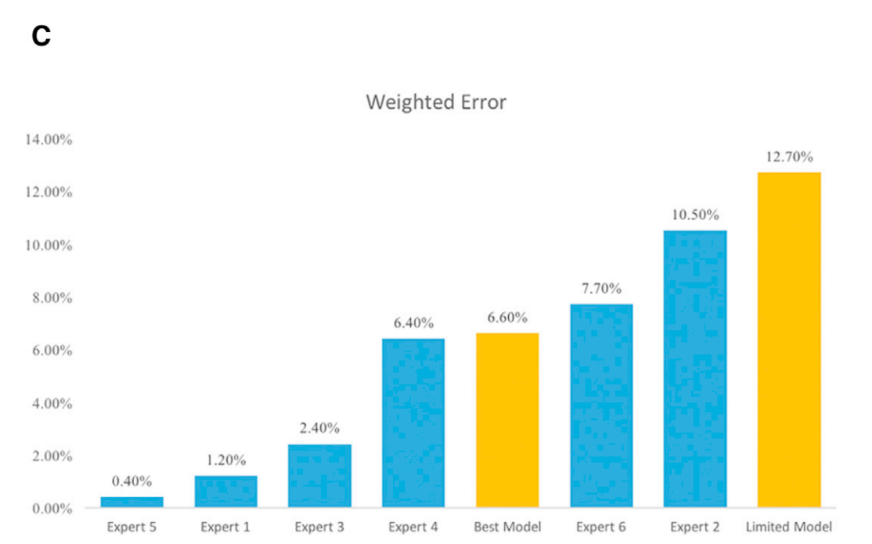
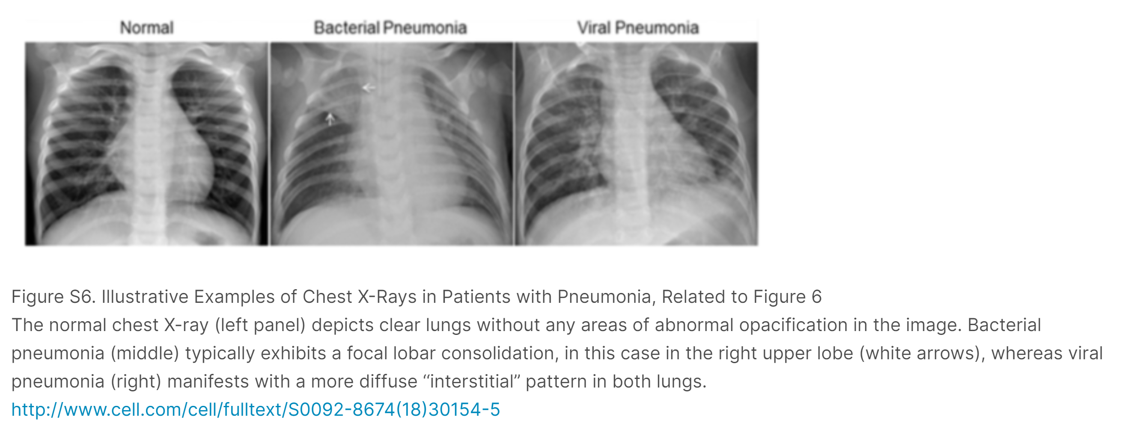
Business Objective: To Improve Treatment through Faster and More Accurate Diagnosis
Reading chest x-rays requires significant skill.
Comparisons to human reading of charts shows a large variation in skill
Childhood pneumonia is most prevalent in countries with limited numbers of skilled personnel to read chest xrays accurately. Delays in diagnosis are critical.
Weighted Error Comparison between human experts and model
(Diabetic Retinopathy Imaging)
Notes:
Kermany et al., 2018, Cell 172, 1122–1131
February 22, 2018 ª 2018 Elsevier Inc.
https://doi.org/10.1016/j.cell.2018.02.010

Slide 5
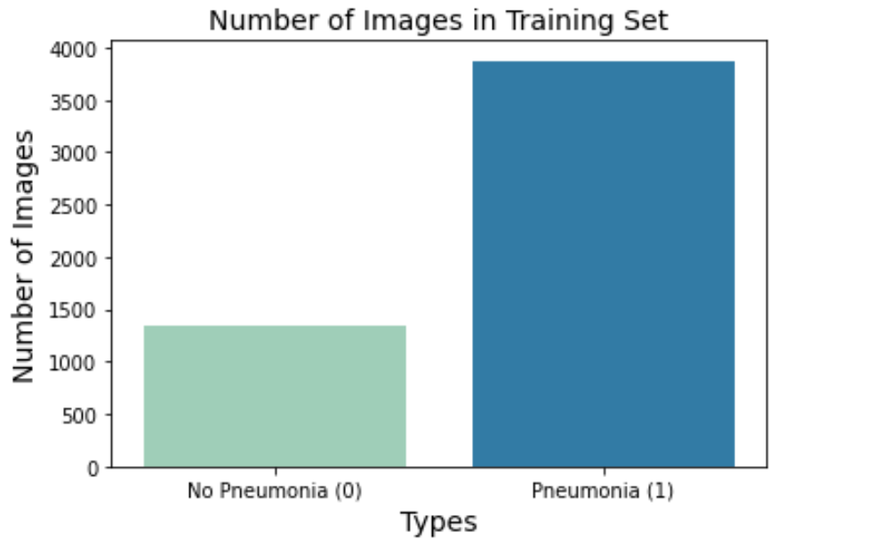
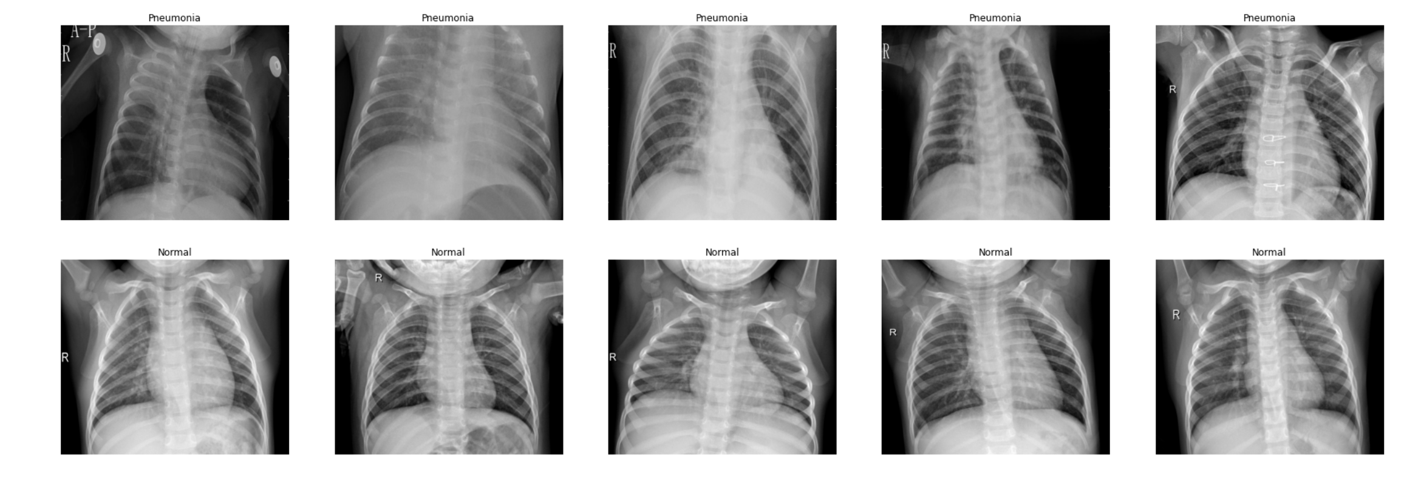
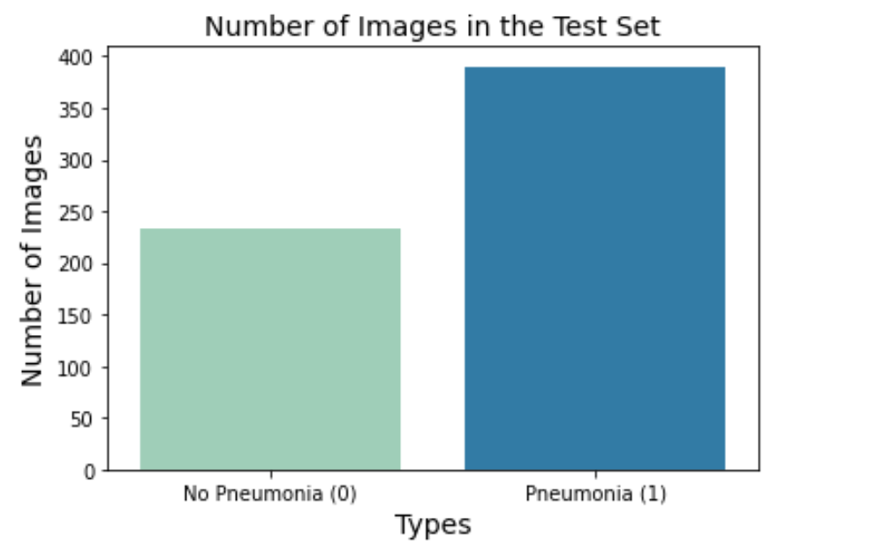
Description of the Dataset
Chest X-ray images of children 1-5 years old
Guangzhou Women and Children’s Medical Center, Guangzhou, China
All radiographs screened for poor imaging quality.
The diagnoses were graded by two expert physicians. The testset was also checked by a third expert.
PNEUMONIA CASES
NORMAL CASES
Notes:
Latest version is V3: Kermany, Daniel; Zhang, Kang; Goldbaum, Michael (2018), “Large Dataset of Labeled Optical Coherence Tomography (OCT) and Chest X-Ray Images”, Mendeley Data, v3http://dx.doi.org/10.17632/rscbjbr9sj.3

Slide 6
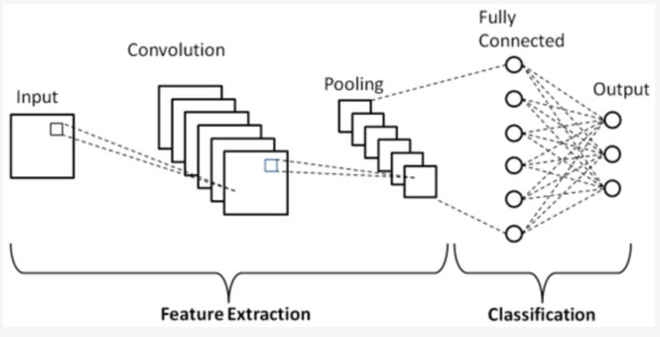
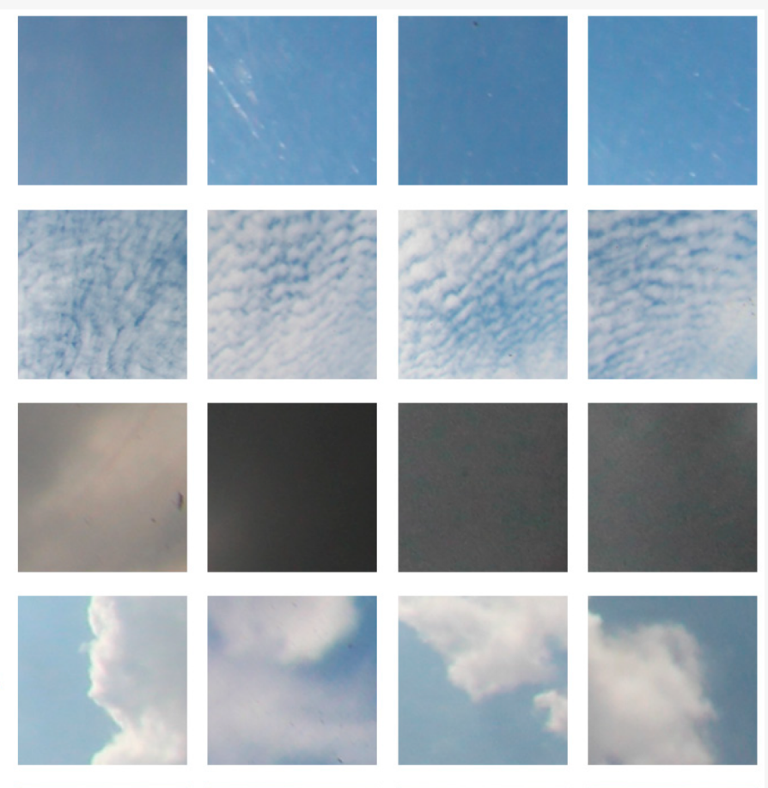
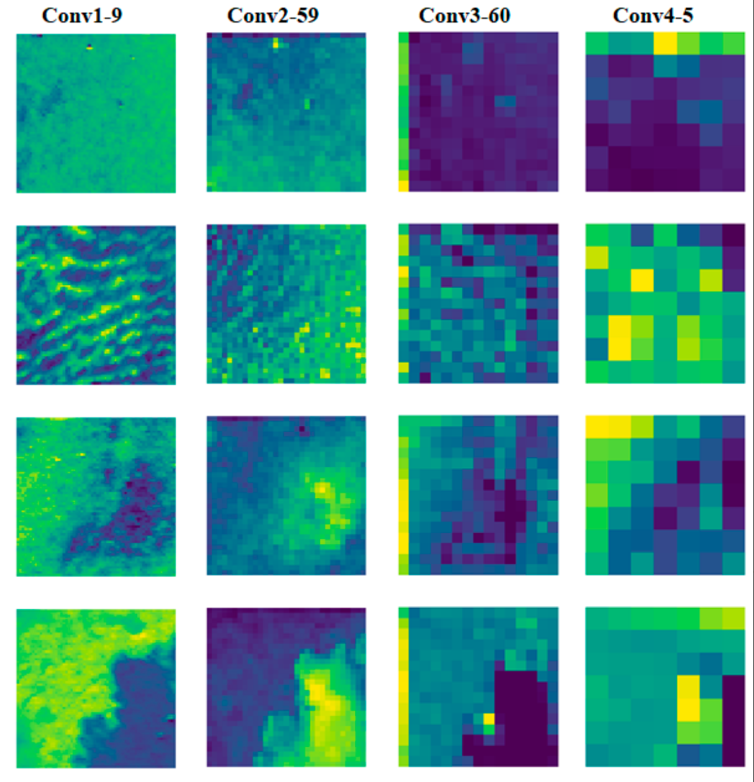
Methods Used – Convolutional Neural Networks A unique branch of Deep Learning specifically towards image classification
Inputs
Image
of objects
Identify type of cloud:
Clear Sky (no cloud)
Patterned clouds
Thick dark cloud
Thick white cloud
Analyse each part of the image
separately, looking for patterns
Re-combine image parts
Identify the
object
Phung, V.H.; Rhee, E.J. A High-Accuracy Model Average Ensemble of Convolutional Neural Networks for Classification of Cloud Image Patches on Small Datasets. Appl. Sci. 2019, 9, 4500.
Notes:
Summarize your research in three to five points.
Phung, V.H.; Rhee, E.J. A High-Accuracy Model Average Ensemble of Convolutional Neural Networks for Classification of Cloud Image Patches on Small Datasets. Appl. Sci. 2019, 9, 4500.

Slide 7
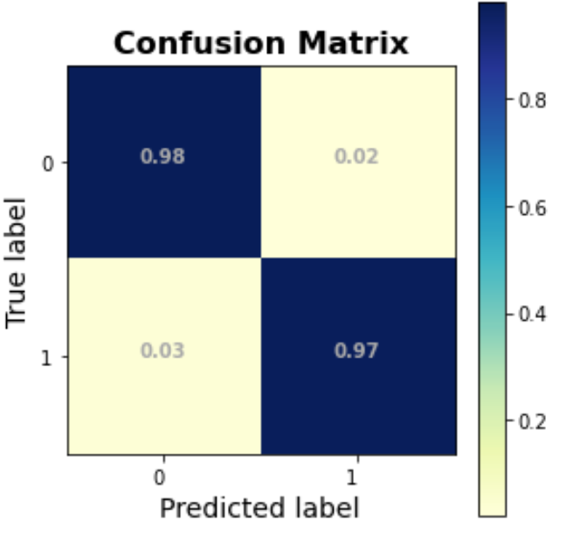
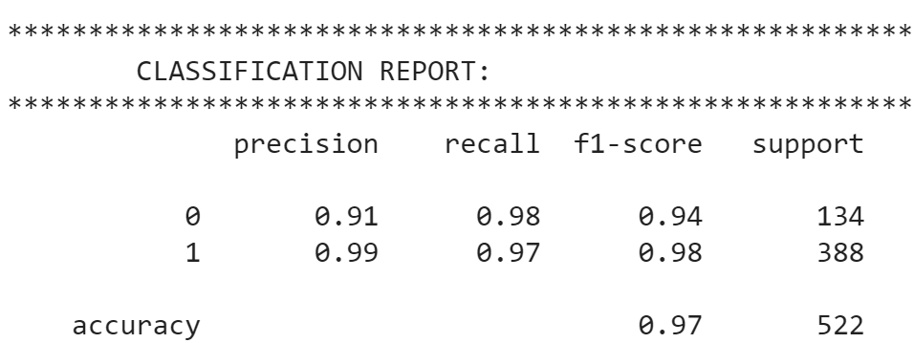
Results – Potential for More Accurate Classification Models
Accuracy of 97% on limited sample data
Conclusion: There is a high potential for a higher accuracy diagnostic models for chest-xrays of childhood pneumonia
1 = has pneumonia
0 = doesn’t have pneumonia
Notes:
Summarize your research in three to five points.

Slide 8
Recommendation - 1
Use Deep Learning Models to aid health care workers, either as a Pre-screening tool, or as 2nd opinion.
Freeing up valuable medical resource time, while improving diagnostic accuracy
Remote diagnosis, especially in regions where there are few skilled technicians to read the x-rays, to speed diagnosis
Weighted Error
This work
Notes:
https://data.mendeley.com/datasets/rscbjbr9sj/2
Kermany, Daniel; Zhang, Kang; Goldbaum, Michael (2018), “Labeled Optical Coherence Tomography (OCT) and Chest X-Ray Images for Classification”, Mendeley Data, v2http://dx.doi.org/10.17632/rscbjbr9sj.2
;
Latest version is V3: Kermany, Daniel; Zhang, Kang; Goldbaum, Michael (2018), “Large Dataset of Labeled Optical Coherence Tomography (OCT) and Chest X-Ray Images”, Mendeley Data, v3http://dx.doi.org/10.17632/rscbjbr9sj.3

Slide 9
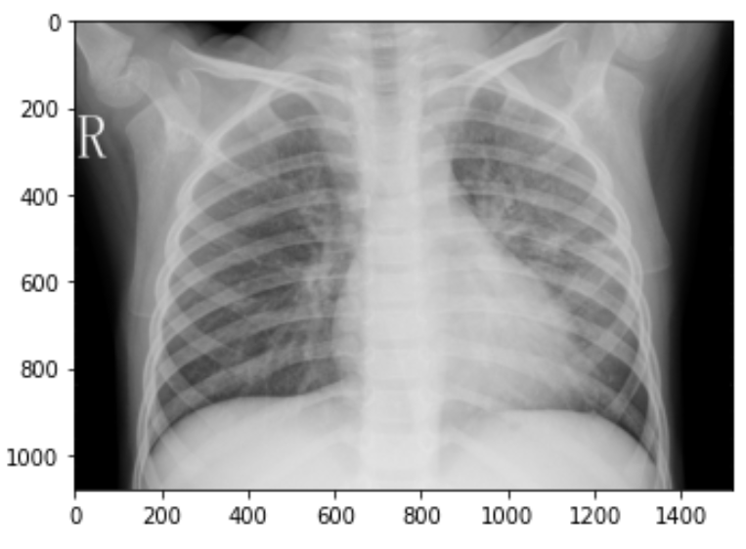
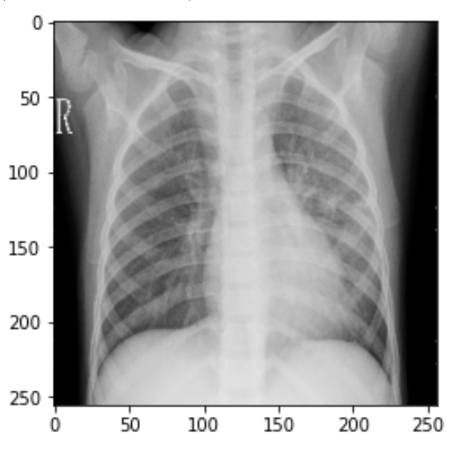
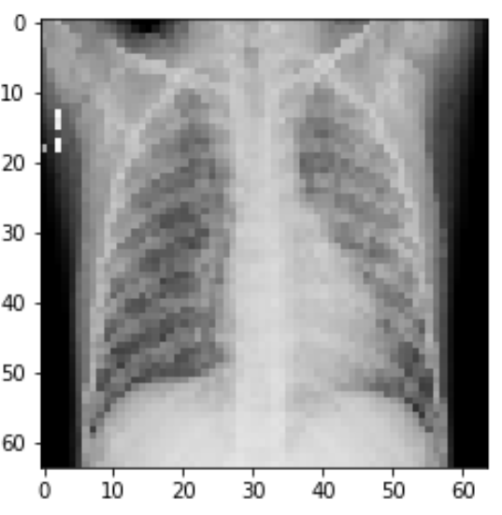
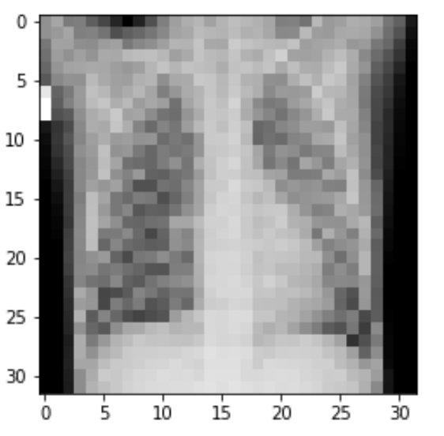
Recommendations – 2 & 3
Try lower resolution images (32,32) or (64,64) for models. Deep learning models are surprisingly good at classification at lower resolution (than usually what humans can do).
This may be a good way to approximate the effect of older, lower resolution x-ray machines, which more impoverished parts of the world
Convolutional Neural Networks work best – choose 2-5 convolutional layers, batch sizes 32-64, with a metric of val_accuracy. Since metrics are collected after each epoch, choosing smaller step size and more epochs enables one to hone in on the best model more easily.
(1080, 1520)
(256 , 256)
(64 , 64)
(32 ,32)
Notes:
https://data.mendeley.com/datasets/rscbjbr9sj/2
Kermany, Daniel; Zhang, Kang; Goldbaum, Michael (2018), “Labeled Optical Coherence Tomography (OCT) and Chest X-Ray Images for Classification”, Mendeley Data, v2http://dx.doi.org/10.17632/rscbjbr9sj.2
;
Latest version is V3: Kermany, Daniel; Zhang, Kang; Goldbaum, Michael (2018), “Large Dataset of Labeled Optical Coherence Tomography (OCT) and Chest X-Ray Images”, Mendeley Data, v3http://dx.doi.org/10.17632/rscbjbr9sj.3

Slide 10
Future Directions
Clearly Deep Learning CNNs are powerful tools for fast and accurate image classification
In the case of medical imaging, the use cases are many, and may provide long-lasting societal benefits
to detect and eliminate disease.
Future directions: Deployment of an application that can be used by health care professionals in the field requires a few more steps such as:
Model Improvements
Generalize the model to diagnose bacterial and viral pneumonia with high accuracy. Since bacterial pneumonia requires immediate antibiotic treatments, this is a priority
Perform Image Augmentation on the dataset to increase model accuracy and stability
Validation with other childhood pneumonia chest-xray data
Check the true positive recall and accuracy with other independent source of data
Application in the field
Images may vary based on x-ray machine type and capability. Build a trained model to handle a variety of inputs.
Another option is to build a self-learning system which tunes specifically to a particular medical clinic and machine type.
Notes:
https://data.mendeley.com/datasets/rscbjbr9sj/2
Kermany, Daniel; Zhang, Kang; Goldbaum, Michael (2018), “Labeled Optical Coherence Tomography (OCT) and Chest X-Ray Images for Classification”, Mendeley Data, v2http://dx.doi.org/10.17632/rscbjbr9sj.2
;
Latest version is V3: Kermany, Daniel; Zhang, Kang; Goldbaum, Michael (2018), “Large Dataset of Labeled Optical Coherence Tomography (OCT) and Chest X-Ray Images”, Mendeley Data, v3http://dx.doi.org/10.17632/rscbjbr9sj.3

Slide 11
Thank You
Questions?
Rebecca.mih@gmail.com
Notes:
Establish hypothesis before you begin the experiment. This should be your best educated guess based on your research.

